Slide 1

Tesla Sales: Visualizing the Journey of Electric Excellence

Slide 2

Team Overview & Introduction
Data Cleaning
Data Exploration
Insights and Trends
Visualizations
Advanced Visualizations
Q & A
AGENDA

Slide 3



Meet Our Team
Vaishnavi Mada
Jarred Carroll
Srujani Mareddy

Slide 4



Introduction
Understanding the Tesla dataset provides valuable insights into current market trends, helping navigate the dynamic landscape of the electric car industry.
Examining factors like pricing, model popularity, and features sheds light on consumer preferences, aiding in strategic decision-making for businesses and policymakers.
The dataset allows exploration of Tesla's advancements in electric vehicle technology, offering a glimpse into the forefront of automotive innovation.

Slide 5


Data Exploration:
Year: The manufacturing year of the Tesla cars.
Odometer: The recorded mileage of each car
Price: The cost associated with each Tesla car
EMI: Monthly installment for car financing.
Zip Code: postal code associated with the car's location.
Model: The specific Tesla car model.
Location: The geographical location of the car.
Location: The geographical location of the car.
Drive Train: The type of drive system employed in each car.
DAS: The type of autonomous driving features.
Accident History: Accident history of the car.
Paint Job: The color of the car's paint job.
Wheels: The type of wheels equipped on the car.
State: The state information associated with the car's location.

Slide 6
Data Preprocessing
Attribute Count Unique Top Frequency
Model
Location
drivetrain
DAS
accident_history
paintjob
Wheels
Interior
State
1912
1864
1869
1912
1912
1912
1912
1912
1864
4
79
23
4
3
10
21
15
18
Model Y
Walnut, GA
Model Y Long Range All Wheel Drive
Autopilot
No Reported Accident/Damage
Pearl white plant
18” Aero wheels
All Black Premium Interior
CA
597
416
361
997
1713
565
455
726
786

Slide 7
Visualizations

Slide 8
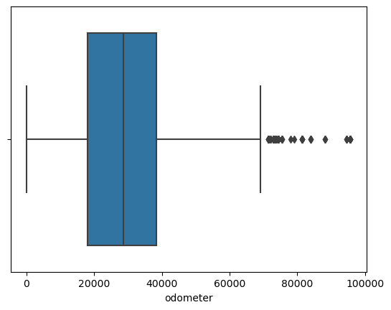
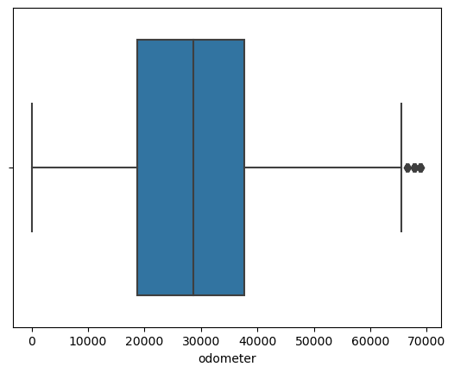
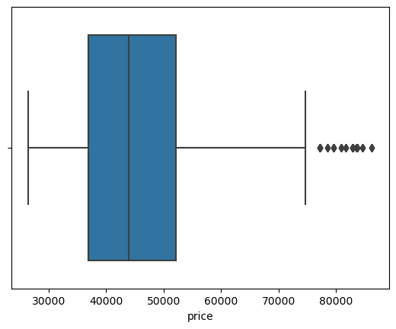
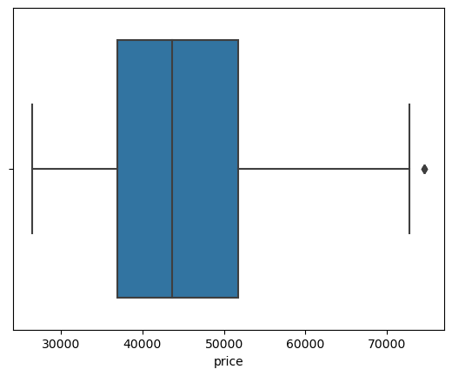
Visualizing outliers
Odometer
Price

Slide 9
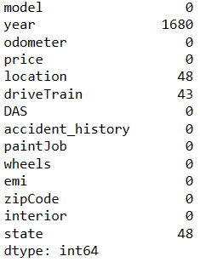
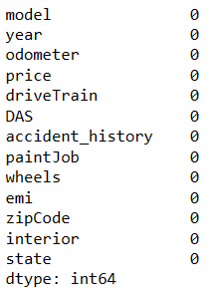
Streamlining Data for Analysis
Data Cleanup: Removing Missing Values in 'driveTrain'
Handling Redundancy: Removing 'location' Column
Imputing Missing 'year' Values
State Imputation from Zip Codes

Slide 10
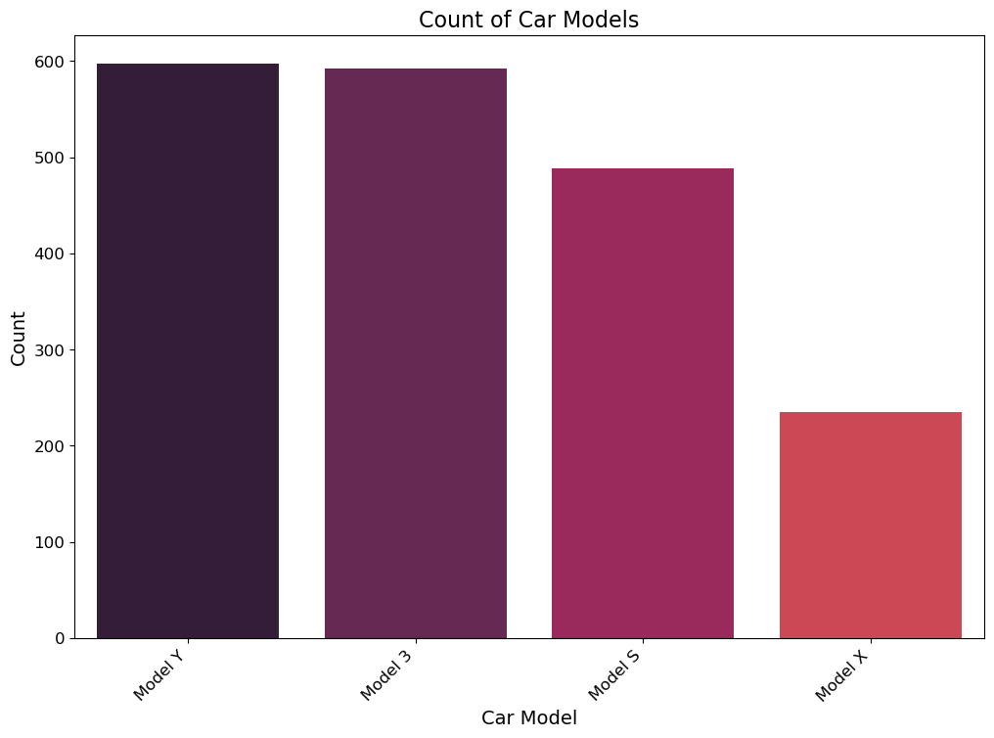
Exploration of Car Models in the Dataset
We explore the distribution of car models within our dataset. The bar chart illustrates the count of each car model, providing insights into the prevalence of different models. Follow Gestalts principles of color harmony
X-axis: Car Models
Y-axis: Count of Occurrences
Title: Count of Car Models
Color palette: ‘rocket’

Slide 11
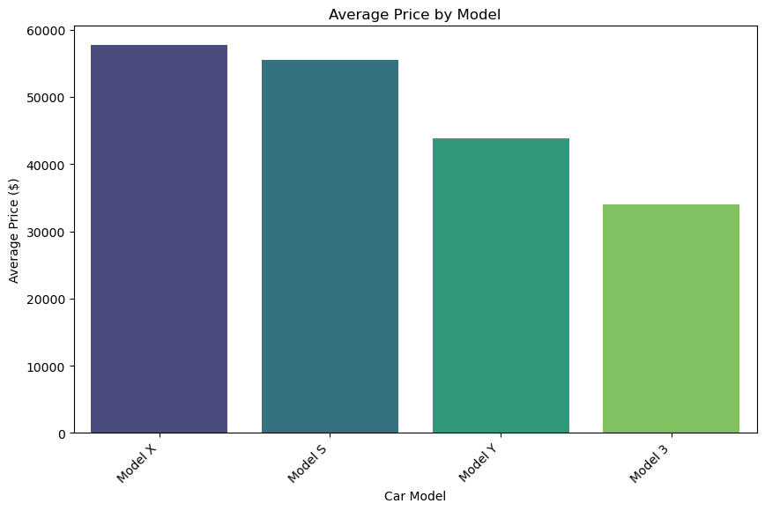
Exploring Price Dynamics: Average Price by Car Model
This bar chart showcases the average price distribution across different car models in our dataset. The 'viridis' color palette visually represents variations in average prices, offering valuable insights into the relative pricing of each car model.
Insights:
Model X have higher Average Price
Model 3 have lower Average Price

Slide 12
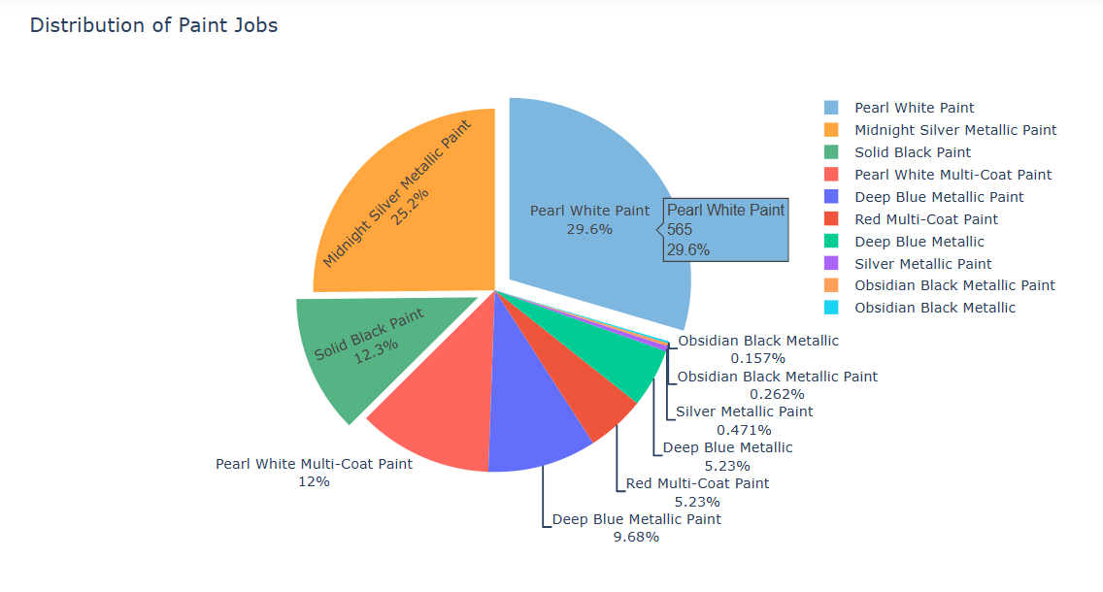
Exploring Paint Job Preferences: Distribution of Paint Jobs
This interactive 3D pie chart visualizes the distribution of paint jobs across our dataset. Used a custom color palette in RGBA format.
Pearl White Paint is popular paint job within the dataset with 29.6%
Followed by Midnight Silver Metallic Paint is popular paint job with 25.2%

Slide 13
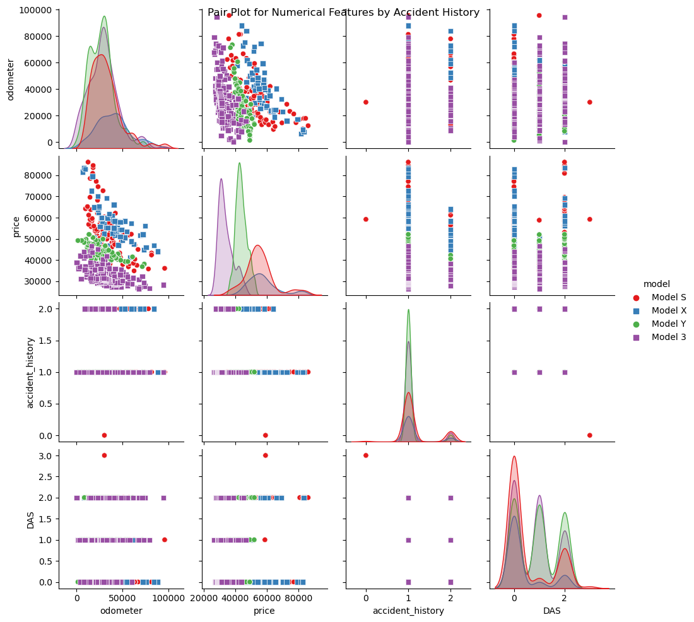
Exploring Relationships: Pair Plot of Numerical Features by Accident History
This pair plot visualizes relationships between selected numerical features—'odometer,' 'price,' and categorical variables such as 'accident_history' and 'DAS.' Each point represents a different car model, distinguished by a unique hue and marker style.

Slide 14
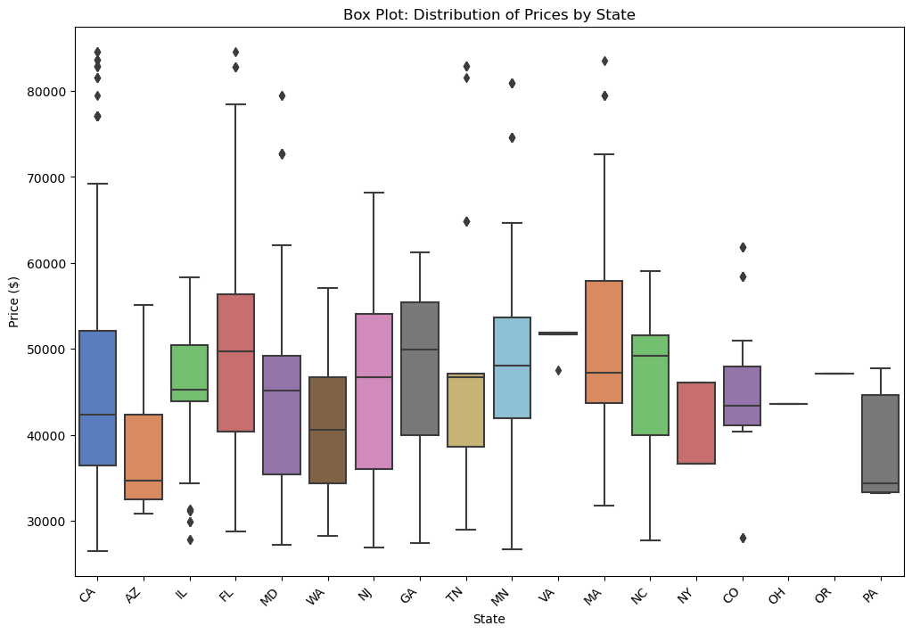
Analyzing Price Variability: Box Plot of Prices Across States
This box plot visually represents the distribution of car prices across different states in our dataset.

Slide 15
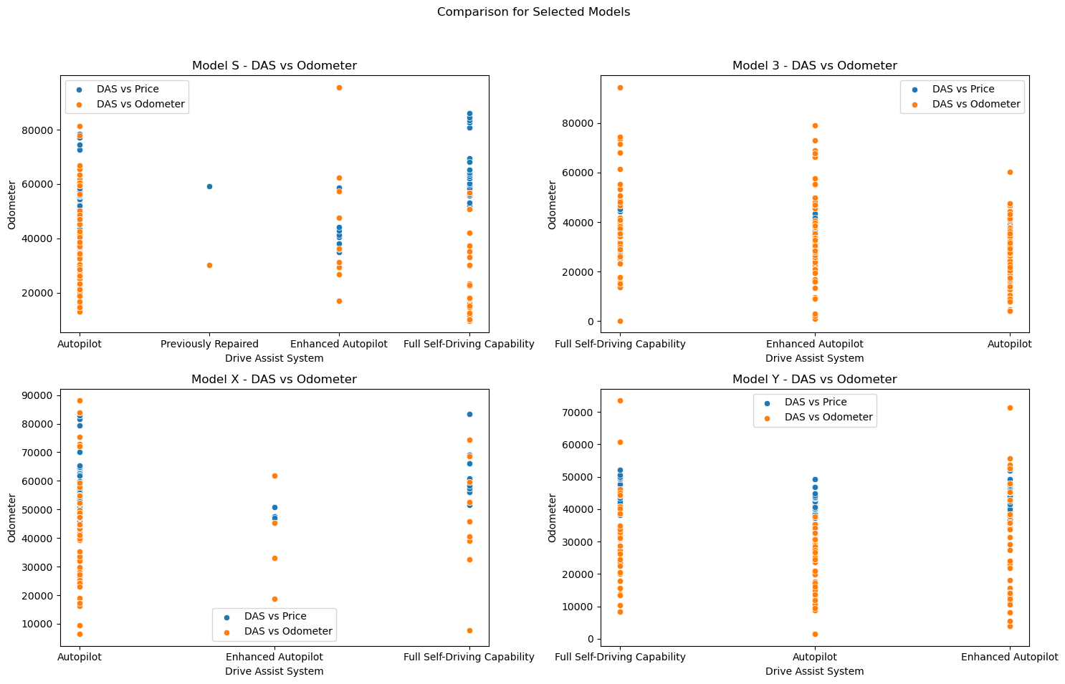
Comparative Analysis of Selected Tesla Models
Comparative analysis for four selected Tesla models: Model S, Model 3, Model X, and Model Y. Each subplot explores the relationships between the presence of a Drive Assist System (DAS) and two essential factors—Price and Odometer reading.

Slide 16
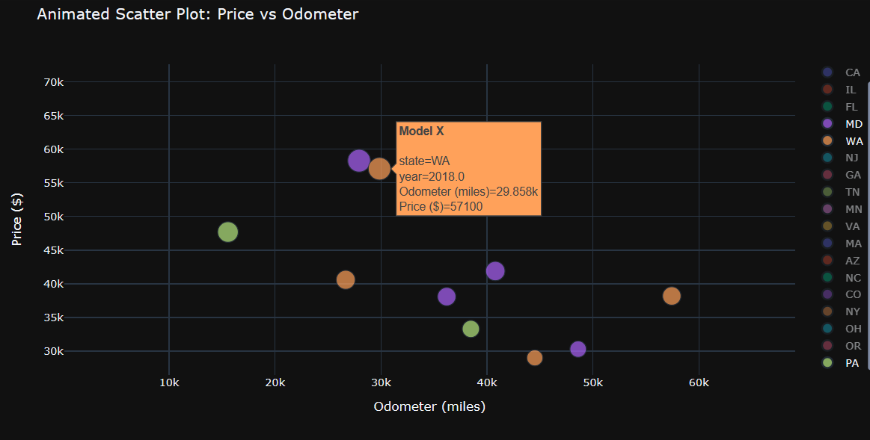
animated_scatter_plot.html
This animated scatter plot dynamically visualizes the relationship between car prices and odometer readings for every model in each state.
Model X in Massachusetts with higher price of $72600 and minimum odometer readings
Model S with higher odometer rating 66.75K and a average price
Dynamic Insights: Animated Scatter Plot of
Price vs Odometer

Slide 17
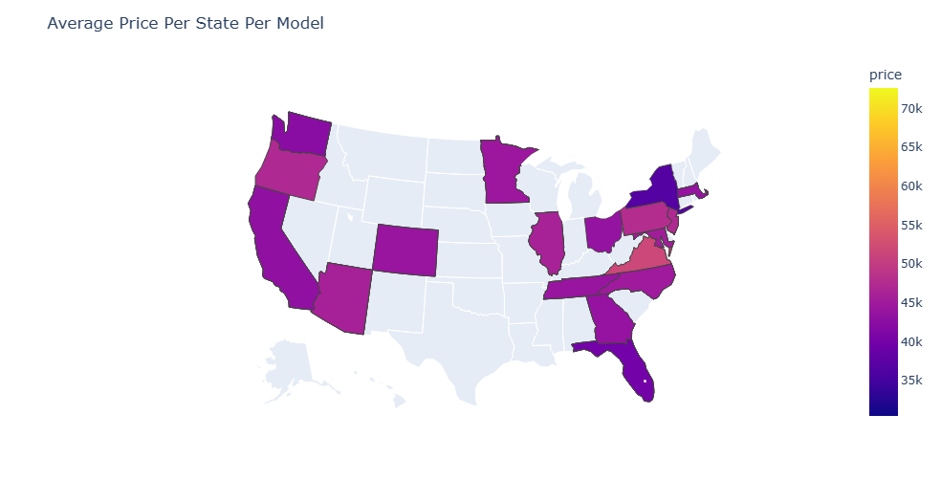
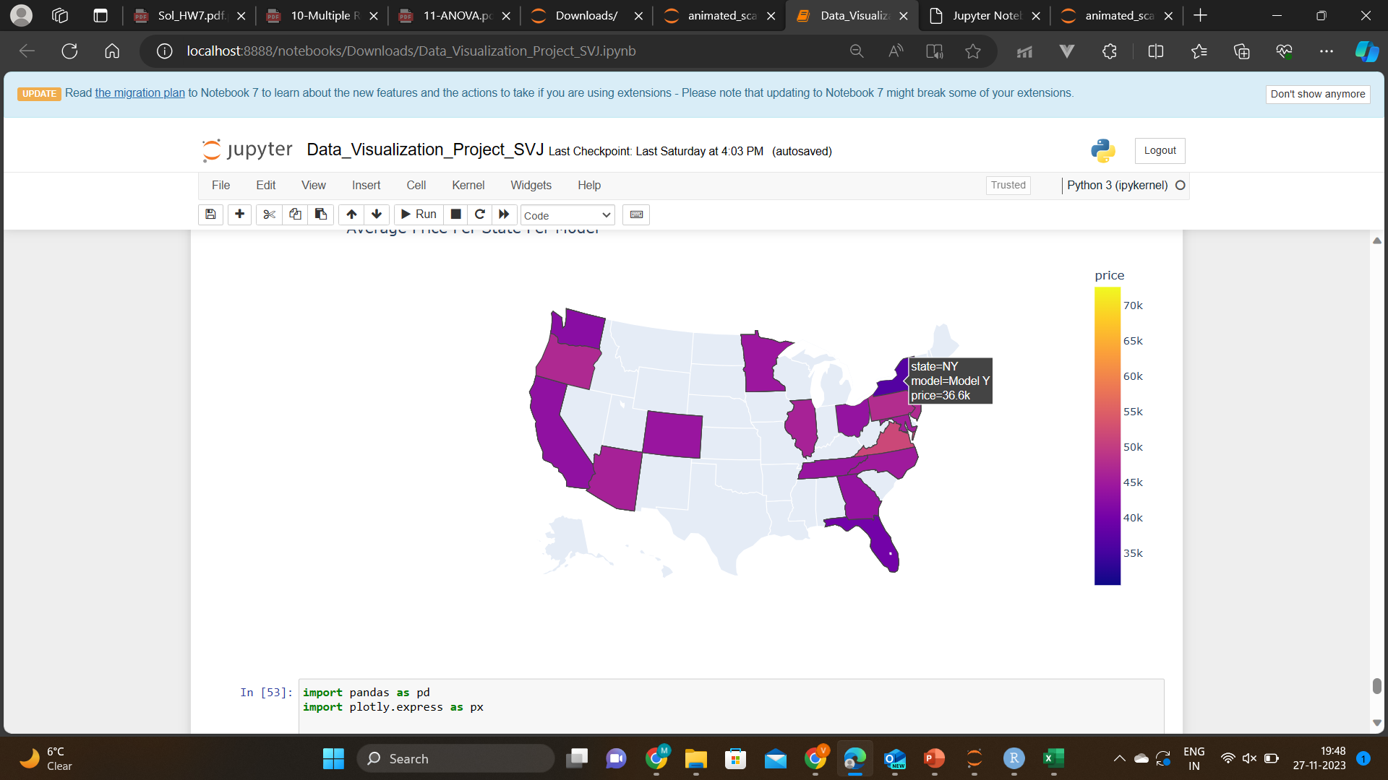
Geographical Insights: Average Price Distribution Across States by Model
choropleth_map.html
This choropleth map visualizes the average car prices across states, providing a geographical perspective on pricing variations.

Slide 18
SUMMARY
The analysis provides valuable insights into the distribution of Tesla used cars, their pricing, and factors influencing them. The visualizations enhance understanding and can be used for informative presentations.

Slide 19
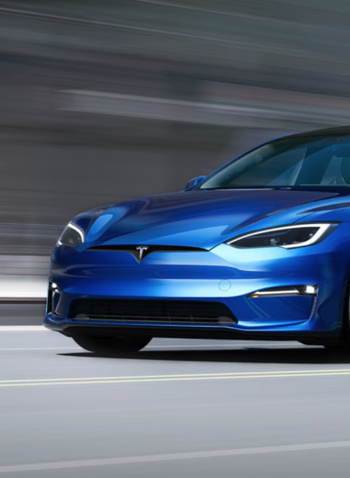
THANK YOU

